Slide 1

Artificial Intelligence
Presented by: Malik Faizan / 4141
Submitted to: Sir Usman
Class: ITM Semester 03

Slide 2


Introduction to Probability‑Based Classification
Probability‑based classification uses probabilistic reasoning to predict which category an input belongs to. It quantifies uncertainty and ranks classes by likelihood — for example, deciding if an email is Spam or Not Spam based on calculated probabilities.
Theme accents: #5A6ED8, #243799 used for emphasis throughout the deck.

Slide 3

Revision of Probability Concepts
Probability measures how likely an event is to occur. Values range from 0 (impossible) to 1 (certain). The basic formula is:
Probability = Favorable outcomes / Total outcomes
Simple example
Toss a fair coin: P(Heads) = 1/2 = 0.5.
Key property
All mutually exclusive outcomes sum to 1 (completeness).

Slide 4

Conditional Probability
Conditional probability describes the probability of an event A given that B has occurred. It refines predictions using available evidence.
Formula: P(A|B) — probability of A when B is true.
Practical intuition
If we know a student studied (B), the chance they pass (A) usually increases: P(Pass | Studied) > P(Pass). Conditional probability is the bridge from raw data to informed prediction.

Slide 5
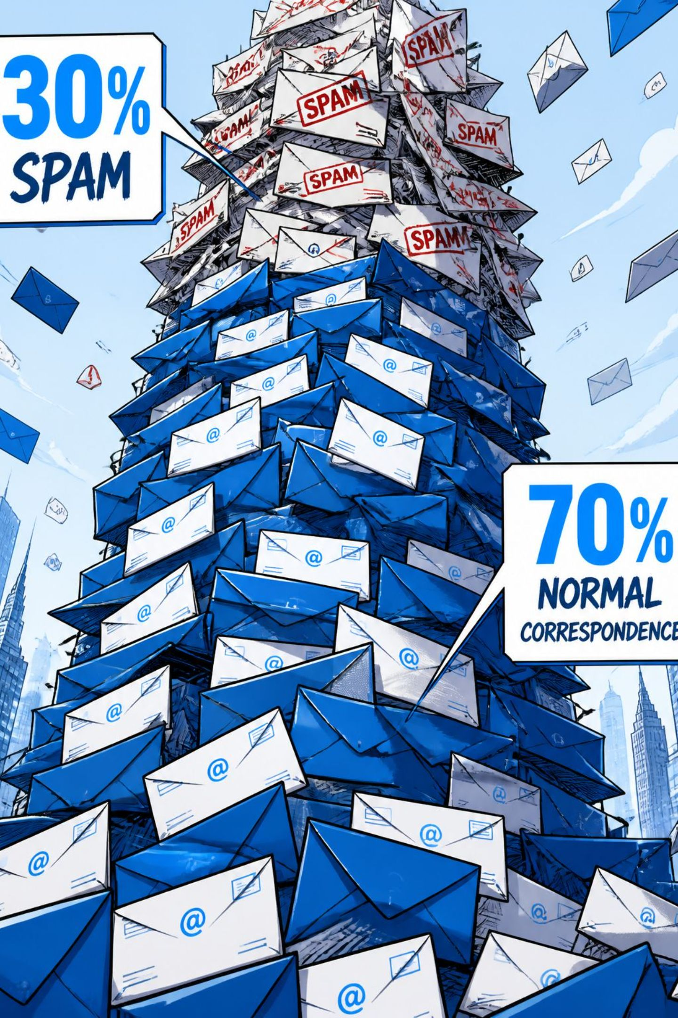
Prior Probability
Prior probability represents initial belief about class frequencies before seeing new evidence. In classification it captures class prevalence in the training data.
How to compute
Example
Prior(class) = count(samples in class) / total samples
If 70% of emails are normal and 30% are spam, then Prior(Normal)=0.70, Prior(Spam)=0.30.

Slide 6


Posterior Probability
Posterior probability is the updated probability of a class after incorporating evidence. It combines the prior with the likelihood of observed features.
In words: Prior → Evidence → Posterior. After seeing words like "Win" or "Free", the posterior probability of an email being spam typically increases.
Posterior is central to Bayesian classifiers — it is what we ultimately compare across classes.

Slide 7
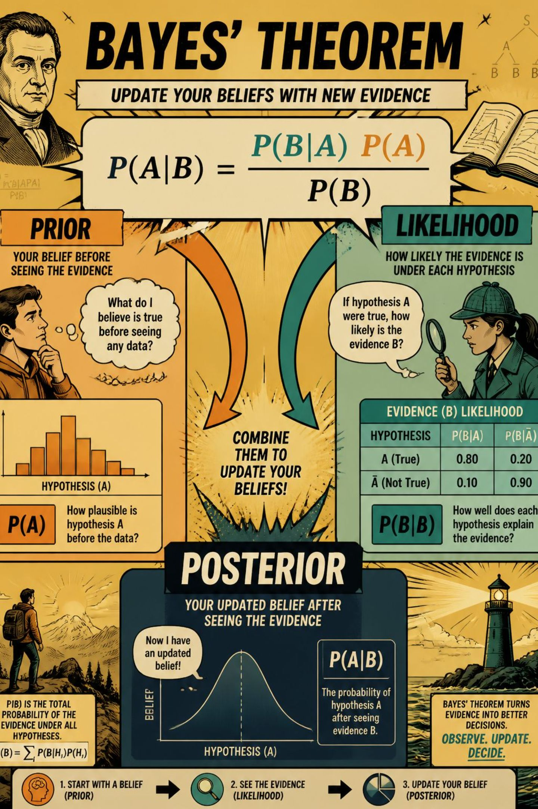
Introduction to Naive Bayes
Naive Bayes is a probabilistic classifier built on Bayes' Theorem. It assumes features are independent given the class — the "naïve" assumption — which simplifies computation and scales to high‑dimensional data.
Why use it
Fast, simple, robust for text tasks (spam, sentiment, topic tagging).
Assumption
Features are conditionally independent given the class — often false but still effective in practice.

Slide 8
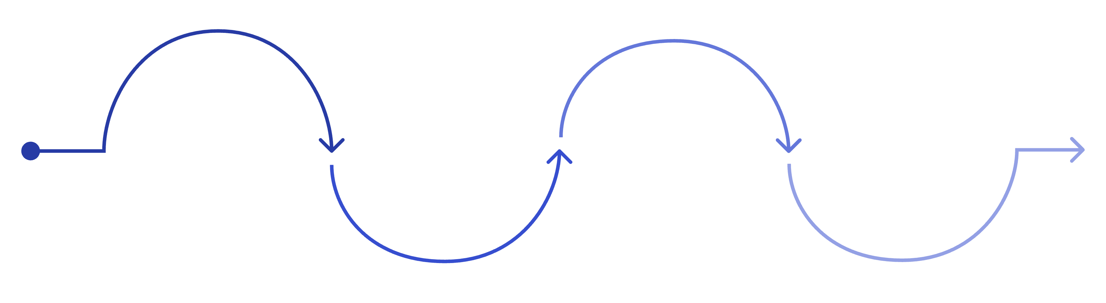
Classify
Collect Data
Estimate Priors
Compute Likelihoods
Compute posteriors and pick highest
Gather labeled training examples
Compute P(class) from labels
Estimate P(feature|class) values
This diagram summarises the algorithmic steps. The model multiplies priors by feature likelihoods to obtain unnormalised posteriors, then selects the class with the highest posterior.

Slide 9
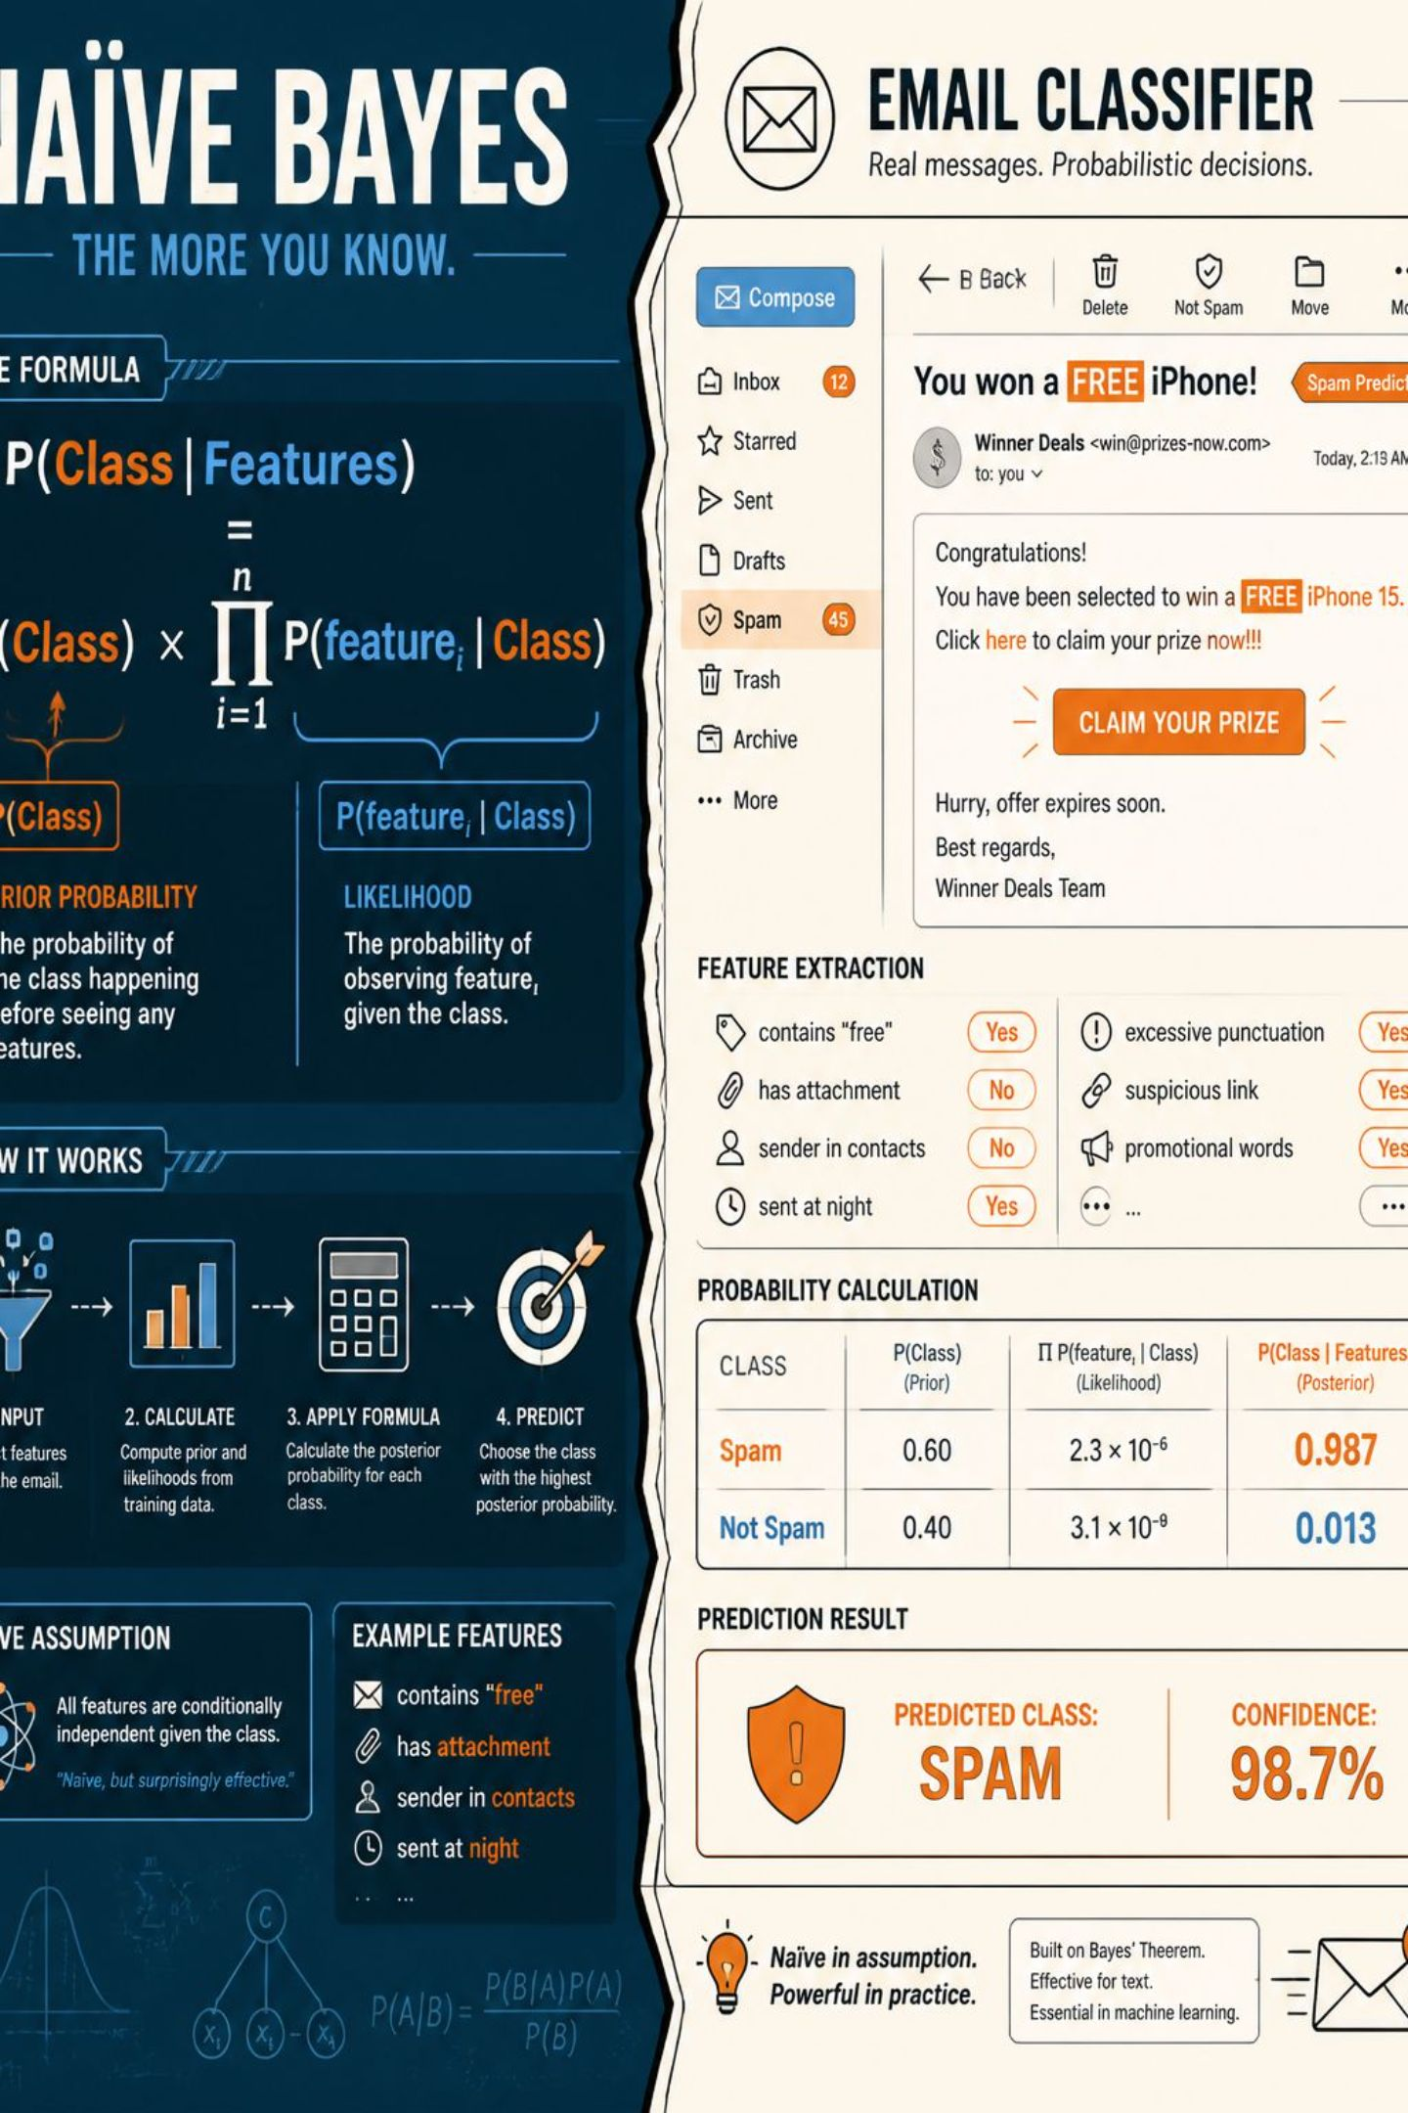
Working of the Naive Bayes Algorithm
For a class C and features f1..fn, Naive Bayes computes:
P(C | f1..fn) ∝ P(C) × Π P(fi | C)
Steps
Estimate P(C) from class frequencies (prior).
Estimate P(fi|C) from feature counts (likelihood).
Multiply and compare posteriors across classes.
Practical notes
Smoothing (e.g., Laplace) prevents zero probabilities.
Use log probabilities to avoid underflow (sum logs instead of multiplying).

Slide 10

Naive Bayes Classification — Example
Given: Prior(Spam)=0.30, Prior(NotSpam)=0.70. For the message "Congratulations! You won a free prize", compute likelihoods of each word given each class, multiply by priors to get posteriors:
If Posterior(Spam) > Posterior(NotSpam) → predict Spam.
Use Laplace smoothing to handle unseen words and log-sums to stabilise computation.
Result: words common in spam raise P(Spam | message) – the classifier assigns the label with the larger posterior.

Slide 11

Advantages, Limitations & Next Steps
Advantages
Limitations
Simple, computationally efficient, scales to large feature sets, effective for text classification, needs little training data.
Strong independence assumption can be violated, zero‑frequency issues without smoothing, ignores feature interactions.
Practical tips
Conclusion
Apply Laplace smoothing, use TF or TF‑IDF feature weighting, prefer log probabilities, evaluate with cross‑validation.
Naive Bayes remains a powerful baseline: interpretable, fast, and often surprisingly accurate for many real‑world classification tasks.
Presented by: Malik Faizan — Submitted to: Sir Usman

Slide 12
Thank you

